Slide 1

Network+ Guide to Networks 6th Edition
Chapter 3
Transmission Basics and Networking Media

Slide 2
Objectives
Explain basic data transmission concepts, including full duplexing, attenuation, latency, and noise
Describe the physical characteristics of coaxial cable, STP, UTP, and fiber-optic media
Compare the benefits and limitations of different networking media
Explain the principles behind and uses for serial cables
Identify wiring standards and the best practices for cabling buildings and work areas

Slide 3
Transmission Basics
Transmit
Issue signals along network medium
Transmission
Process of transmitting
Signal progress after transmitting
Transceiver
Transmits and receives signals

Slide 4
Analog and Digital Signaling
Important data transmission characteristic
Signaling type: analog or digital
Volt
Electrical current pressure
Electrical signal strength
Directly proportional to voltage
Signal voltage
Signals
Current, light pulses, electromagnetic waves

Slide 5
Analog and Digital Signaling (cont’d.)
Analog data signals
Voltage varies continuously
Fundamental properties of analog signals
Amplitude
Measure of strength at given point in time
Frequency
Number of times amplitude cycles over fixed time
Wavelength
Distance between one peak and the next
Phase
Progress of wave over time compared to a fixed point

Slide 6
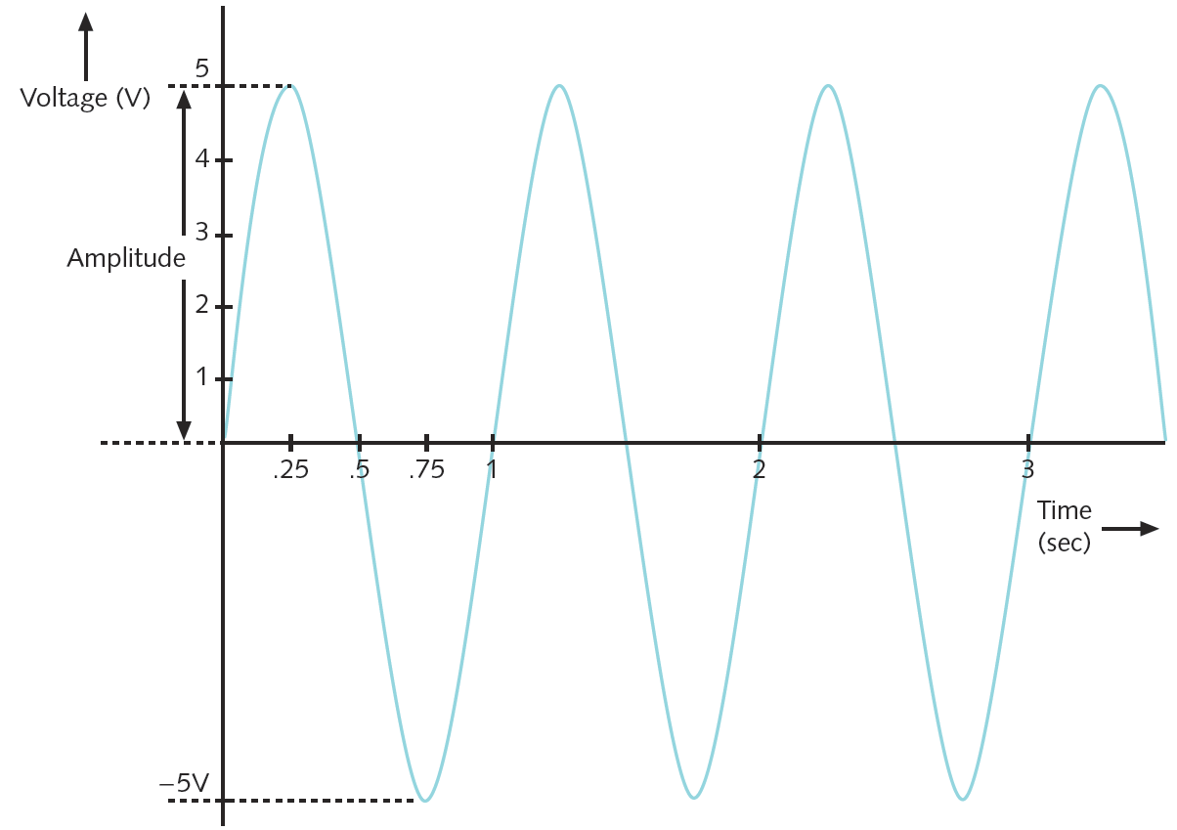
Figure 3-1 An example of an analog signal
Courtesy Course Technology/Cengage Learning

Slide 7
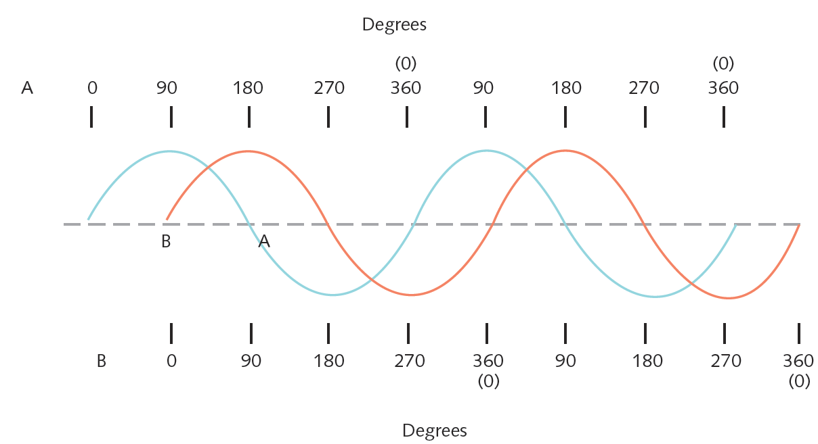
Figure 3-2 Waves with a 90 degree phase difference
Courtesy Course Technology/Cengage Learning

Slide 8
Analog and Digital Signaling (cont’d.)
Analog signal benefit over digital
More variable
Convey greater subtleties with less energy
Drawback of analog signals
Varied and imprecise voltage
Susceptible to transmission flaws
Digital signals
Pulses of voltages
Positive voltage represents a 1
Zero voltage represents a 0

Slide 9
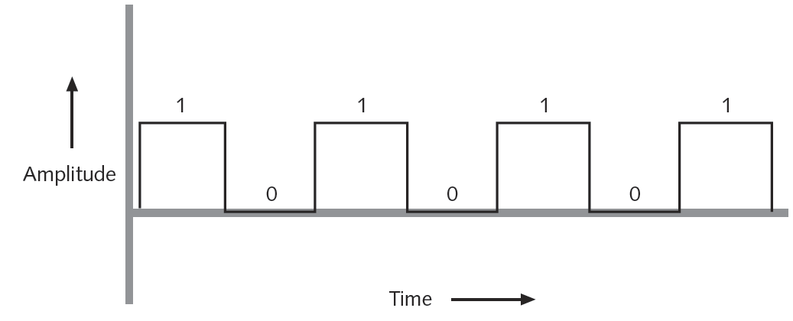
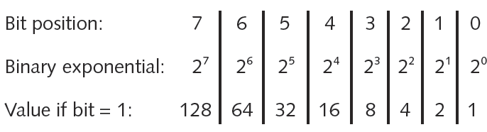
Figure 3-3 An example of a digital signal
Courtesy Course Technology/Cengage Learning
Figure 3-4 Components of a byte
Courtesy Course Technology/Cengage Learning

Slide 10
Analog and Digital Signaling (cont’d.)
Convert byte to decimal number
Determine value represented by each bit
Add values
Convert decimal number to a byte
Reverse the process
Convert between binary and decimal
By hand or calculator

Slide 11
Analog and Digital Signaling (cont’d.)
Digital signal benefit over analog signal
More reliable
Less severe noise interference
Digital signal drawback
Many pulses required to transmit same information
Overhead
Nondata information
Required for proper signal routing and interpretation
Example: network layer addressing information

Slide 12
Data Modulation
Data relies on digital transmission
Network connection may handle only analog signals
Modem
Accomplishes translation
Modulator/demodulator
Data modulation
Technology modifying analog signals
Make data suitable for carrying over communication path

Slide 13
Data Modulation (cont’d.)
Carrier wave
Combined with another analog signal
Produces unique signal
Transmitted from one node to another
Preset properties
Purpose: convey information
Information wave (data wave)
Added to carrier wave
Modifies one carrier wave property

Slide 14
Data Modulation (cont’d.)
Frequency modulation
Carrier frequency modified by application of data signal
Amplitude modulation
Carrier signal amplitude modified by application of data signal
Digital subscriber line (DSL)
Also makes use of modulation

Slide 15
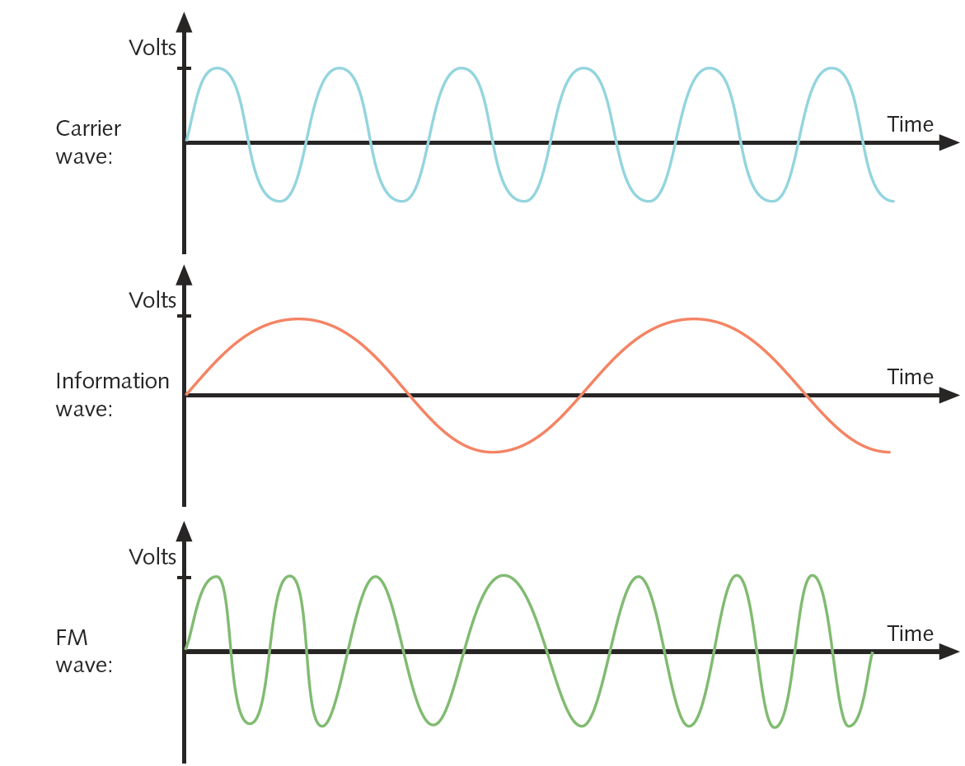
Figure 3-5 A carrier wave modified through frequency modulation
Courtesy Course Technology/Cengage Learning

Slide 16
Simplex, Half-Duplex, and Duplex
Simplex
Signals travel in one direction
Half-duplex transmission
Signals travel in both directions
One at a time
Shared communication channel
Full-duplex
Signals travel in both directions simultaneously
Used on data networks

Slide 17
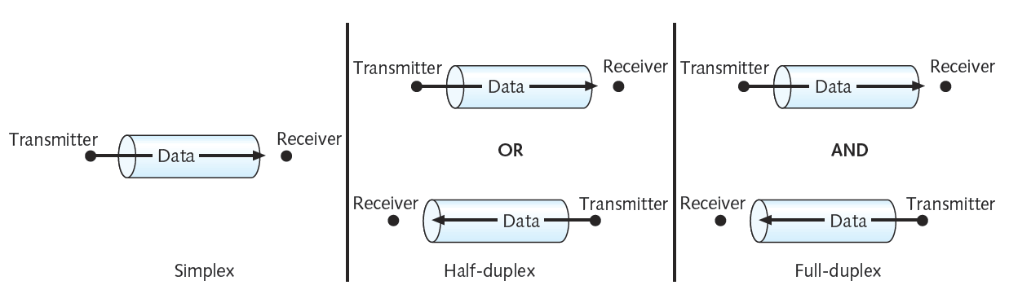
Figure 3-6 Simplex, half-duplex, and full-duplex transmission
Courtesy Course Technology/Cengage Learning

Slide 18
Simplex, Half-Duplex, and Duplex (cont’d.)
Channel
Distinct communication path between nodes
Separated physically or logically
Full duplex advantage
Increases speed of data travel
Some modems and NICs allow specifying half- or full-duplex communication
Modern NICs use full duplex by default

Slide 19
Multiplexing
Multiplexing
Multiple signals
Travel simultaneously over one medium
Subchannels
Logical multiple smaller channels
Multiplexer (mux)
Combines many channel signals
Demultiplexer (demux)
Separates combined signals
Regenerates them

Slide 20
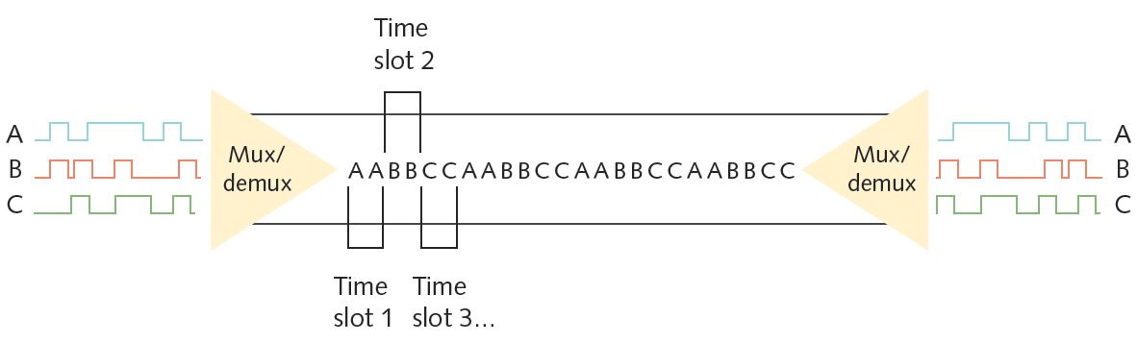
Multiplexing (cont’d.)
Time division multiplexing (TDM)
Divides channel into multiple time intervals
Figure 3-7 Time division multiplexing
Courtesy Course Technology/Cengage Learning

Slide 21
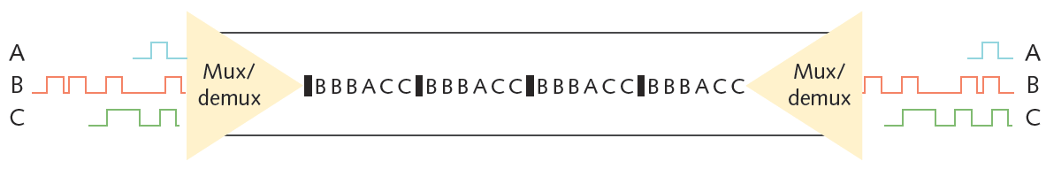
Multiplexing (cont’d.)
Statistical multiplexing
Transmitter assigns slots to nodes
According to priority, need
More efficient than TDM
Figure 3-8 Statistical multiplexing
Courtesy Course Technology/Cengage Learning

Slide 22
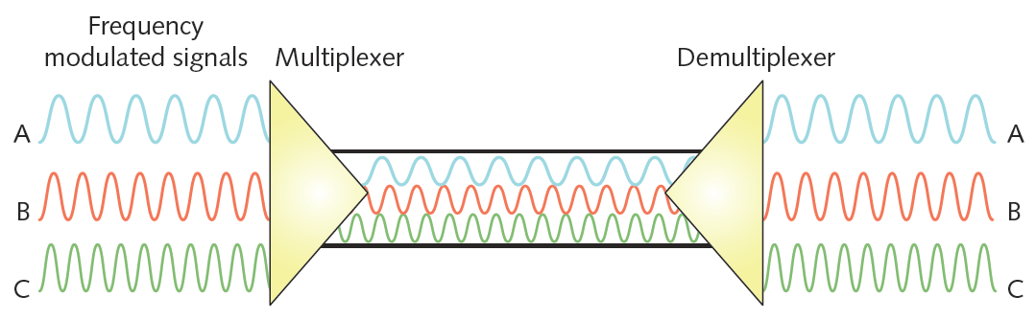
Multiplexing (cont’d.)
Frequency division multiplexing (FDM)
Unique frequency band for each communications subchannel
Cellular telephone transmission
DSL Internet access
Figure 3-9 Frequency division multiplexing
Courtesy Course Technology/Cengage Learning

Slide 23
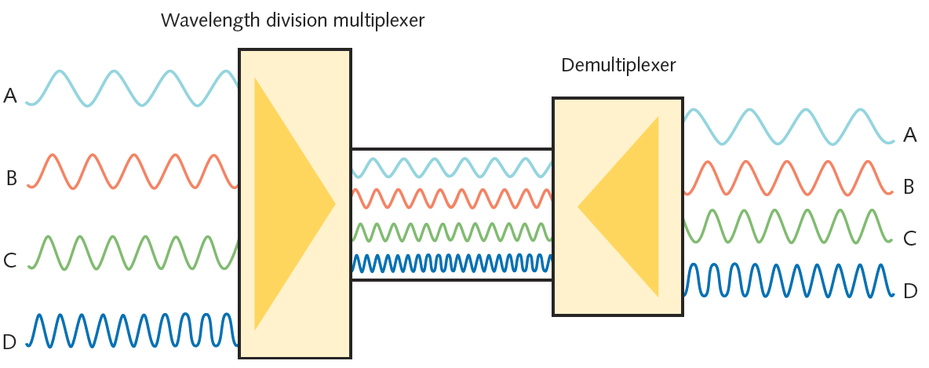
Multiplexing (cont’d.)
Wavelength division multiplexing (WDM)
One fiber-optic connection
Carries multiple light signals simultaneously
Figure 3-10 Wavelength division multiplexing
Courtesy Course Technology/Cengage Learning

Slide 24
Multiplexing (cont’d.)
Dense wavelength division multiplexing (DWDM)
Used on most modern fiber-optic networks
Extraordinary capacity

Slide 25
Relationships Between Nodes
Point-to-point transmission
One transmitter and one receiver
Point-to-multipoint transmission
One transmitter and multiple receivers
Broadcast transmission
One transmitter and multiple, undefined receivers
Used on wired and wireless networks
Simple and quick
Nonbroadcast
One transmitter and multiple, defined recipients

Slide 26
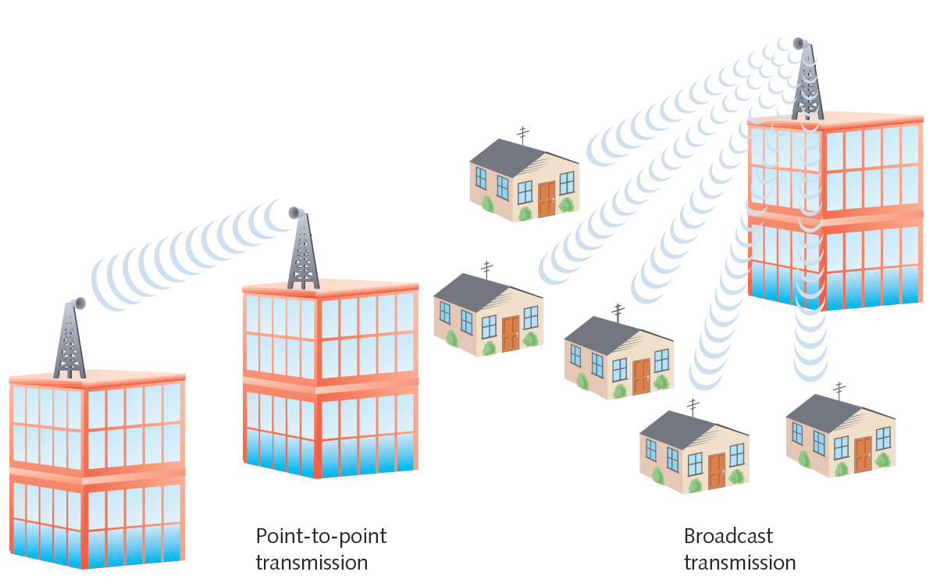
Figure 3-11 Point-to-point versus broadcast transmission
Courtesy Course Technology/Cengage Learning

Slide 27
Throughput and Bandwidth
Throughput
Amount of data transmitted during given time period
Also called capacity or bandwidth
Expressed as bits transmitted per second
Bandwidth (strict definition)
Difference between highest and lowest frequencies medium can transmit
Range of frequencies
Measured in hertz (Hz)

Slide 28
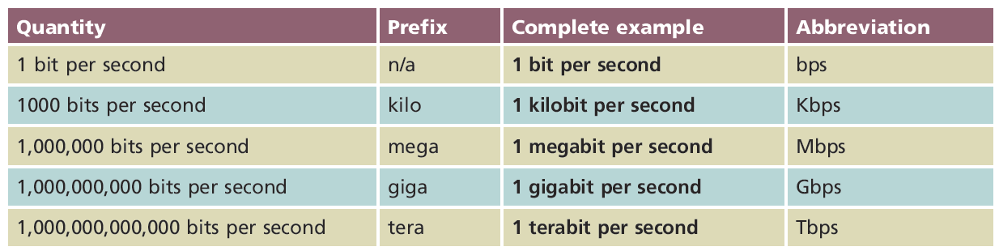
Table 3-1 Throughput measures
Courtesy Course Technology/Cengage Learning

Slide 29
Baseband and Broadband
Baseband transmission
Digital signals sent through direct current (DC) pulses applied to wire
Requires exclusive use of wire’s capacity
Transmit one signal (channel) at a time
Example: Ethernet
Broadband transmission
Signals modulated as radio frequency (RF) analog waves
Uses different frequency ranges
Does not encode information as digital pulses

Slide 30
Transmission Flaws
Noise
Any undesirable influence degrading or distorting signal
Types of noise
EMI (electromagnetic interference)
Example: radio frequency interference
Cross talk
Signal on one wire infringes on adjacent wire signal
Near end cross talk (NEXT) occurs near source

Slide 31
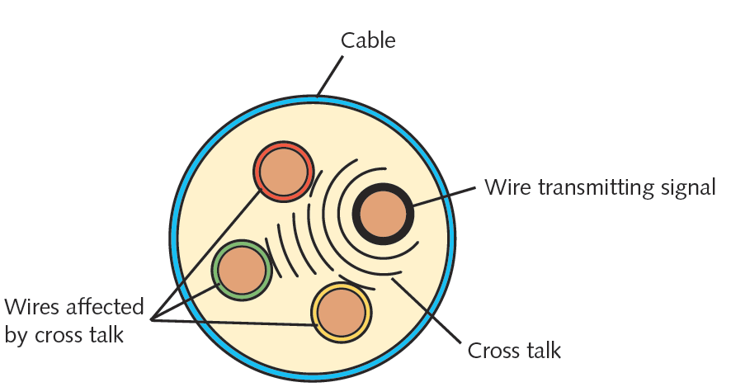
Figure 3-12 Cross talk between wires in a cable
Courtesy Course Technology/Cengage Learning

Slide 32
Transmission Flaws (cont’d.)
Attenuation
Loss of signal’s strength as it travels away from source
Signal boosting technology
Analog signals pass through amplifier
Noise also amplified
Regeneration
Digital signals retransmitted in original form
Repeater: device regenerating digital signals
Amplifiers and repeaters
OSI model Physical layer

Slide 33
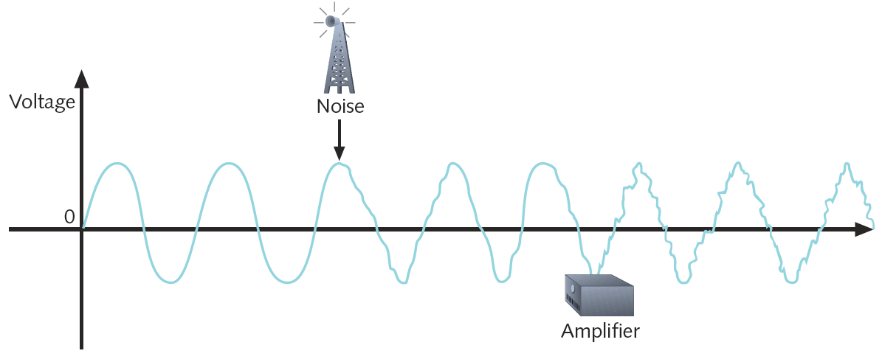
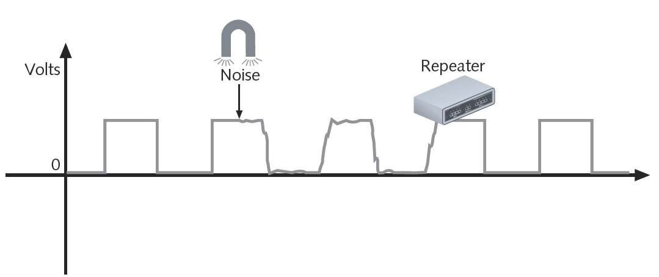
Figure 3-13 An analog signal distorted by noise and then amplified
Courtesy Course Technology/Cengage Learning
Figure 3-14 A digital signal distorted by noise and then repeated
Courtesy Course Technology/Cengage Learning

Slide 34
Transmission Flaws (cont’d.)
Latency
Delay between signal transmission and receipt
May cause network transmission errors
Latency causes
Cable length
Intervening connectivity device
Round trip time (RTT)
Time for packet to go from sender to receiver, then back from receiver to sender

Slide 35
Common Media Characteristics
Selecting transmission media
Match networking needs with media characteristics
Physical media characteristics
Throughput
Cost
Noise immunity
Size and scalability
Connectors and media converters

Slide 36
Throughput
Most significant factor in choosing transmission method
Causes of throughput limitations
Laws of physics
Signaling and multiplexing techniques
Noise
Devices connected to transmission medium
Fiber-optic cables allow faster throughput
Compared to copper or wireless connections

Slide 37
Cost
Precise costs difficult to pinpoint
Media cost dependencies
Existing hardware, network size, labor costs
Variables influencing final cost
Installation cost
New infrastructure cost versus reuse
Maintenance and support costs
Cost of lower transmission rate affecting productivity
Cost of downtime
Cost of obsolescence

Slide 38
Noise Immunity
Noise distorts data signals
Distortion rate dependent upon transmission media
Fiber-optic: least susceptible to noise
Limit noise impact on network
Cable installation
Far away from powerful electromagnetic forces
Select media protecting signal from noise
Antinoise algorithms

Slide 39
Size and Scalability
Three specifications
Maximum nodes per segment
Maximum segment length
Maximum network length
Maximum nodes per segment dependency
Attenuation and latency
Maximum segment length dependency
Attenuation and latency plus segment type

Slide 40
Size and Scalability (cont’d.)
Segment types
Populated: contains end nodes
Unpopulated: no end nodes
Also called link segment
Segment length limitation
After certain distance, signal loses strength
Cannot be accurately interpreted

Slide 41
Connectors and Media Converters
Connectors
Hardware connecting wire to network device
Specific to particular media type
Affect costs
Installing and maintaining network
Ease of adding new segments or nodes
Technical expertise required to maintain network
Media converter
Hardware enabling networks or segments running on different media to interconnect and exchange signals

Slide 42
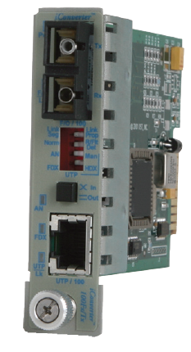
Figure 3-15 Copper wire-to-fiber media converter
Courtesy of Omnitron Systems Technology

Slide 43
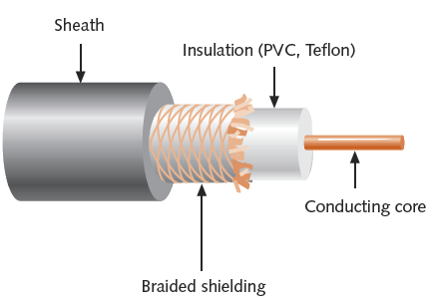
Coaxial Cable
Central metal core (often copper) surrounded by:
Insulator
Braided metal shielding (braiding or shield)
Outer cover (sheath or jacket)
Figure 3-16 Coaxial cable
Courtesy Course Technology/Cengage Learning

Slide 44
Coaxial Cable (cont’d.)
High noise resistance
Advantage over twisted pair cabling
Carry signals farther before amplifier required
Disadvantage over twisted pair cabling
More expensive
Hundreds of specifications
RG specification number
Differences: shielding and conducting cores
Transmission characteristics
RG: Radio Guide

Slide 45
Coaxial Cable (cont’d.)
Conducting core
American Wire Gauge (AWG) size
Larger AWG size, smaller wire diameter
Data networks usage
RG-6
RG-8
RG-58
RG-59

Slide 46
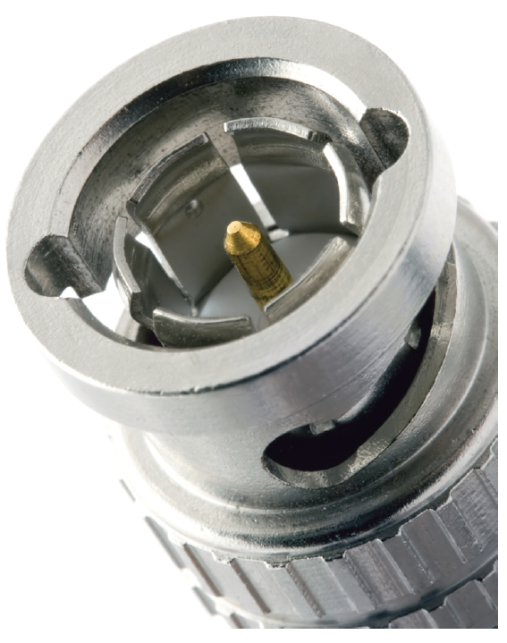
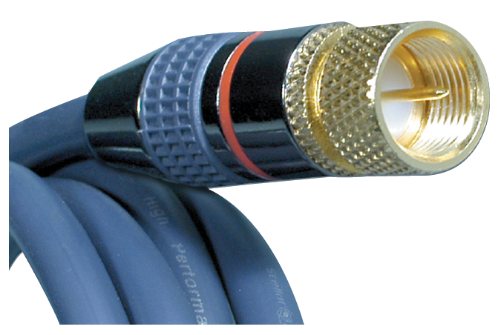
Figure 3-17 F-Type connector
Figure 3-18 BNC connector
Courtesy of MCM Electronics, Inc.
© Igor Smichkov/Shutterstock.com

Slide 47
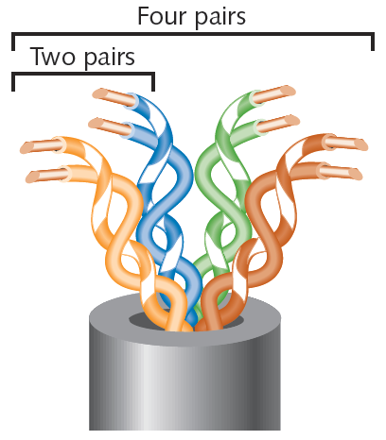
Twisted Pair Cable
Color-coded insulated copper wire pairs
0.4 to 0.8 mm diameter
Encased in a plastic sheath
Figure 3-19 Twisted pair cable
Courtesy Course Technology/Cengage Learning

Slide 48
Twisted Pair Cable (cont’d.)
More wire pair twists per foot
More resistance to cross talk
Higher-quality
More expensive
Twist ratio
Twists per meter or foot
High twist ratio
Greater attenuation

Slide 49
Twisted Pair Cable (cont’d.)
Hundreds of different designs
Twist ratio, number of wire pairs, copper grade, shielding type, shielding materials
1 to 4200 wire pairs possible
Wiring standard specification
TIA/EIA 568
Most common twisted pair types
Category (cat) 3, 5, 5e, 6, 6a, 7
CAT 5 or higher used in modern LANs

Slide 50
Twisted Pair Cable (cont’d.)
Advantages
Relatively inexpensive
Flexible
Easy installation
Spans significant distance before requiring repeater
Accommodates several different topologies
Two categories
Shielded twisted pair (STP)
Unshielded twisted pair (UTP)

Slide 51
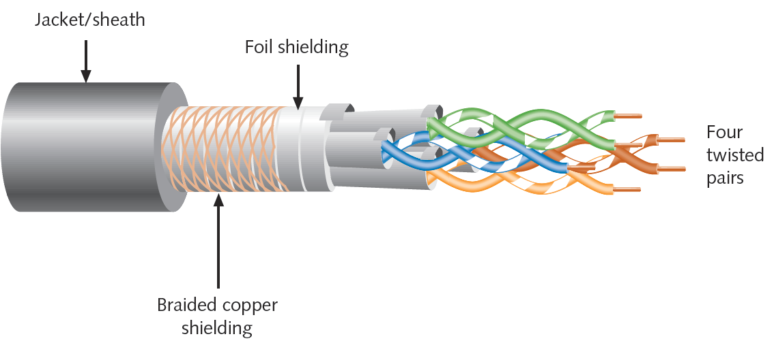
STP (Shielded Twisted Pair)
Individually insulated
Surrounded by metallic substance shielding (foil)
Barrier to external electromagnetic forces
Contains electrical energy of signals inside
May be grounded
Figure 3-20 STP cable
Courtesy Course Technology/Cengage Learning

Slide 52
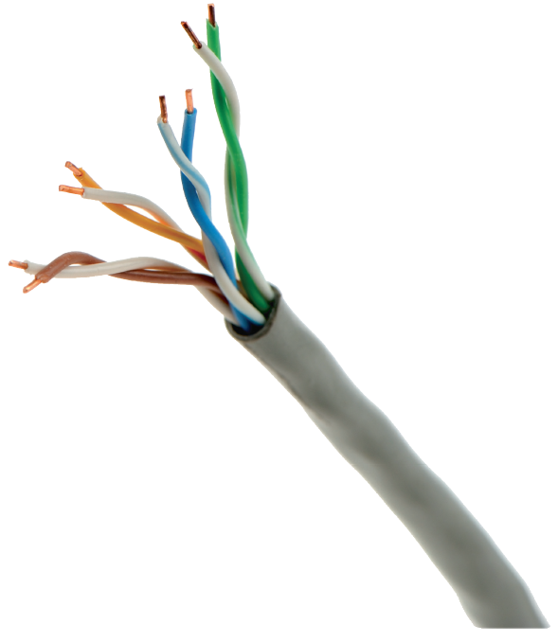
UTP (Unshielded Twisted Pair)
One or more insulated wire pairs
Encased in plastic sheath
No additional shielding
Less expensive, less noise resistance
Figure 3-21 UTP cable
Courtesy Course Technology/Cengage Learning

Slide 53
Comparing STP and UTP
Throughput
STP and UTP can transmit the same rates
Cost
STP and UTP vary
Connector
STP and UTP use Registered Jack 45
Telephone connections use Registered Jack 11

Slide 54
Comparing STP and UTP (cont’d.)
Noise immunity
STP more noise resistant
Size and scalability
Maximum segment length for both: 100 meters

Slide 55
Terminating Twisted Pair Cable
Patch cable
Relatively short cable
Connectors at both ends
Proper cable termination techniques
Basic requirement for two nodes to communicate
Poor terminations:
Lead to loss or noise
TIA/EIA standards
TIA/EIA 568A
TIA/EIA 568B

Slide 56
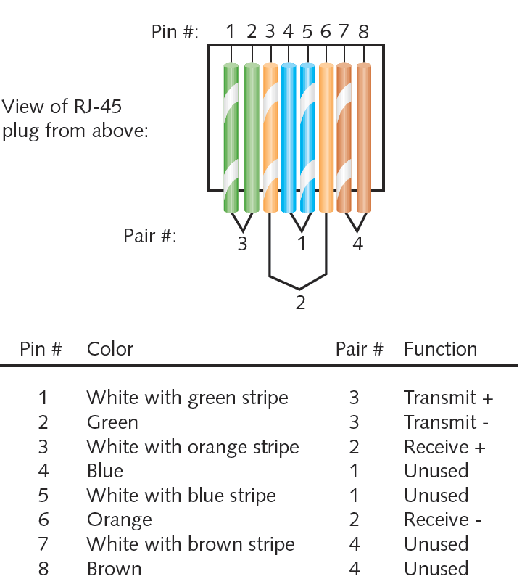
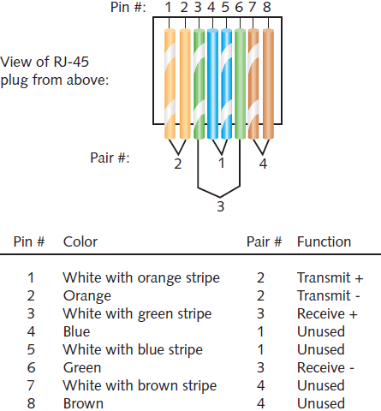
Figure 3-24 TIA/EIA 568A standard terminations
Figure 3-25 TIA/EIA 568B standard terminations
Courtesy Course Technology/Cengage Learning
Courtesy Course Technology/Cengage Learning

Slide 57
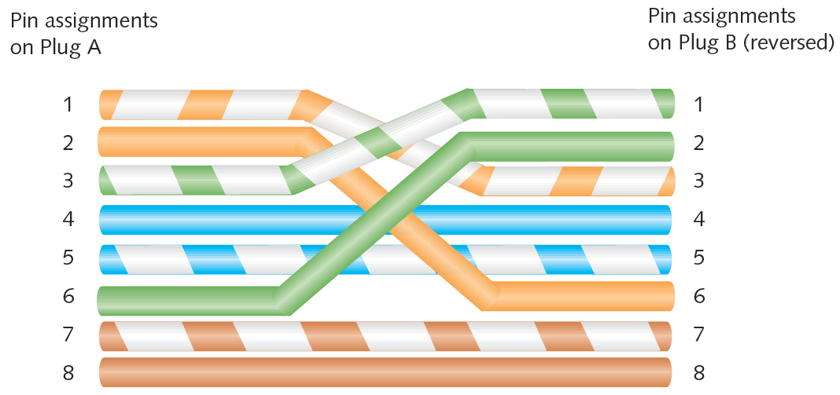
Terminating Twisted Pair Cable (cont’d.)
Straight-through cable
Terminate RJ-45 plugs at both ends identically
Crossover cable
Transmit and receive wires on one end reversed
Figure 3-26 RJ-45 terminations on a crossover cable
Courtesy Course Technology/Cengage Learning

Slide 58
Terminating Twisted Pair Cable (cont’d.)
Termination tools
Wire cutter
Wire stripper
Crimping tool
After making cables:
Verify data transmit and receive

Slide 59
Fiber-Optic Cable
Fiber-optic cable (fiber)
One or more glass or plastic fibers at its center (core)
Data transmission
Pulsing light sent from laser or light-emitting diode (LED) through central fibers
Cladding
Layer of glass or plastic surrounding fibers
Different density from glass or plastic in strands
Reflects light back to core
Allows fiber to bend

Slide 60
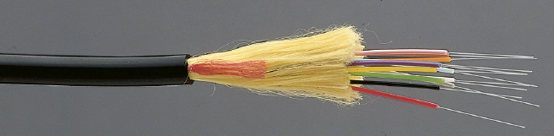
Fiber-Optic Cable (cont’d.)
Plastic buffer outside cladding
Protects cladding and core
Opaque to absorb escaping light
Surrounded by Kevlar (polymeric fiber) strands
Plastic sheath covers Kevlar strands
Figure 3-30 A fiber-optic cable
Courtesy of Optical Cable Corporation

Slide 61
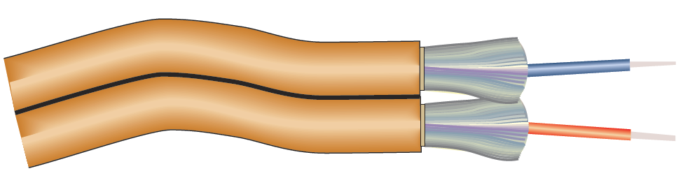
Fiber-Optic Cable (cont’d.)
Different varieties
Based on intended use and manufacturer
Figure 3-31 Zipcord fiber-optic patch cable
Courtesy Course Technology/Cengage Learning

Slide 62
Fiber-Optic Cable (cont’d.)
Benefits over copper cabling
Extremely high throughput
Very high noise resistance
Excellent security
Able to carry signals for longer distances
Industry standard for high-speed networking
Drawbacks
More expensive than twisted pair cable
Requires special equipment to splice

Slide 63
SMF (Single-Mode Fiber)
Consists of narrow core (8-10 microns in diameter)
Laser-generated light travels over one path
Little reflection
Light does not disperse as signal travels
Can carry signals many miles:
Before repeating required
Rarely used for shorter connections
Due to cost

Slide 64
MMF (Multimode Fiber)
Contains core with larger diameter than single-mode fiber
Common sizes: 50 or 62.5 microns
Laser or LED generated light pulses travel at different angles
Greater attenuation than single-mode fiber
Common uses
Cables connecting router to a switch
Cables connecting server on network backbone

Slide 65
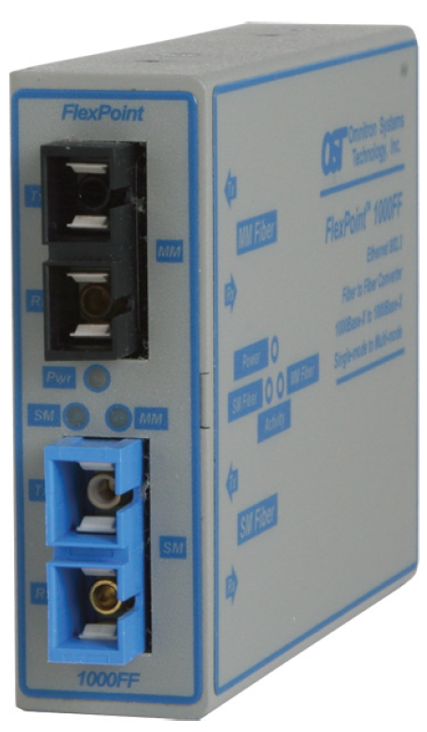
Fiber-Optic Converters
Required to connect multimode fiber networks to single-mode fiber networks
Also fiber- and copper-based parts of a network
Figure 3-38 Single-mode to multimode converter
Courtesy Omnitron Systems Technology

Slide 66
Serial Cables
Data transmission style
Pulses issued sequentially, not simultaneously
Serial transmission method
RS-232
Uses DB-9, DB-25, and RJ-45 connectors

Slide 67
Structured Cabling
Cable plant
Hardware that makes up the enterprise cabling system
Cabling standard
TIA/EIA’s joint 568 Commercial Building Wiring Standard
Also known as structured cabling
Based on hierarchical design

Slide 68
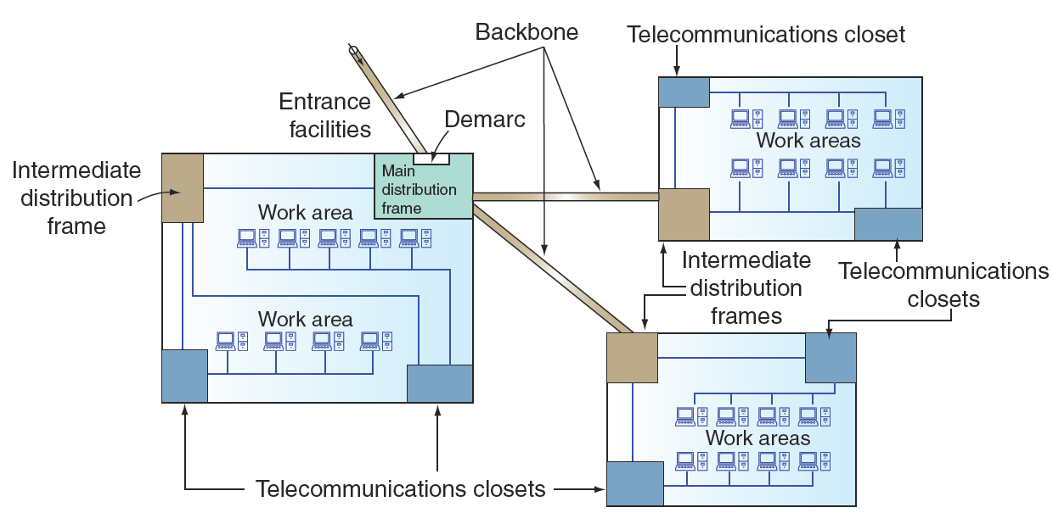
Figure 3-42 TIA/EIA structured cabling in an enterprise
Courtesy Course Technology/Cengage Learning

Slide 69
Structured Cabling (cont’d.)
Components
Entrance facilities
MDF (main distribution frame)
Cross-connect facilities
IDF (intermediate distribution frame)
Backbone wiring
Telecommunications closet
Horizontal wiring
Work area

Slide 70
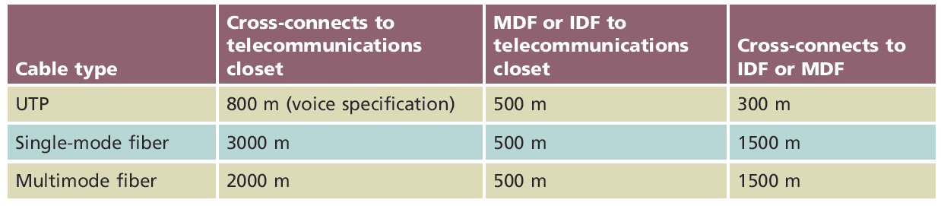
Structured Cabling (cont’d.)
Table 3-2 TIA/EIA specifications for backbone cabling
Courtesy Course Technology/Cengage Learning

Slide 71
Best Practices for Cable Installation and Management
Choosing correct cabling
Follow manufacturers’ installation guidelines
Follow TIA/EIA standards
Network problems
Often traced to poor cable installation techniques
Installation tips to prevent Physical layer failures
See Pages 121-122 in the text

Slide 72
Summary
Information transmission methods
Analog
Digital
Multiplexing allows multiple signals to travel simultaneously over one medium
Full and half-duplex specifies whether signals can travel in both directions or one direction at a time
Noise distorts both analog and digital signals
Attenuation
Loss of signal as it travels

Slide 73
Summary (cont’d.)
Coaxial cable composed of core, insulator, shielding, sheath
Types of twisted pair cable
Shielded and unshielded
Fiber-optic cable transmits data through light passing through the central fibers

Slide 74
Summary (cont’d.)
Fiber-optic cable categories
Single and multimode fiber
Serial communication often used for short connections between devices
Structured cabling standard provides wiring guidelines

